Slide 1
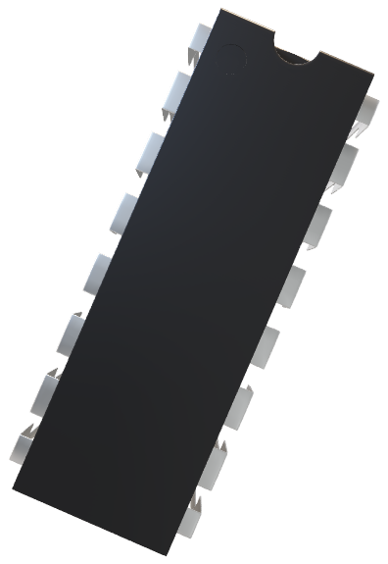
COAL lab Project_
ATM Machine System
Data Section_
Defines various data segments, such as account information, passwords, and messages.
TOTAL is set to 20, and two sets of IDs (IDS1 and IDS2) and passwords (PASSWORDS1 and PASSWORDS2) are provided.
Strings for various messages, prompts, and error messages are defined (e.g., DATA1 to DATA31).
ACCOUNT_BALANCE is initialized to 1000 as the initial account balance.
Arrays IDINPUT and PASSINPUT are declared to store user input for ID and password, respectively.
TRIES_LEFT is set to 3, representing the number of password attempts allowed.

Slide 2
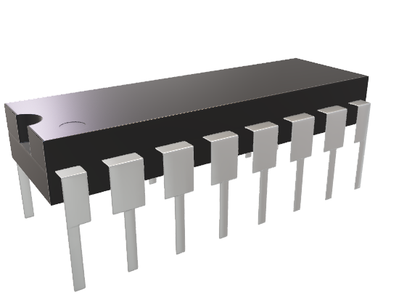
Submitted To
MAAM MARIA ALI
Submitted By_
Musharib Rehman Awais Anser Huzaifa Amjad Abdullah Rashid Umair Noor Muhammad Rizwan

Slide 3
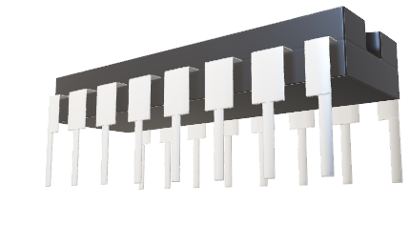
Data Section_
Defines various data segments, such as account information, passwords, and messages.
TOTAL is set to 20, and two sets of IDs (IDS1 and IDS2) and passwords (PASSWORDS1 and PASSWORDS2) are provided.
Strings for various messages, prompts, and error messages are defined (e.g., DATA1 to DATA31).
ACCOUNT_BALANCE is initialized to 1000 as the initial account balance.
Arrays IDINPUT and PASSINPUT are declared to store user input for ID and password, respectively.
TRIES_LEFT is set to 3, representing the number of password attempts allowed.

Slide 4
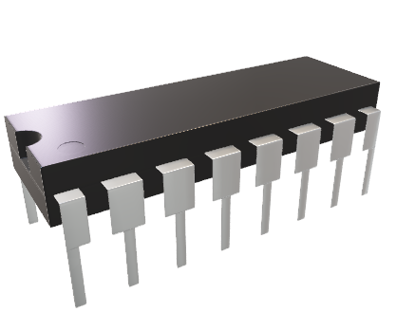
Code Section_
The program starts at the START label.
It initializes the data segment and displays a welcome message along with options to log in or sign up.
User input is taken to determine whether to log in or sign up.

Slide 5
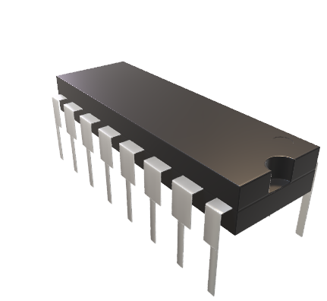
Subroutines_
The code defines several subroutines using macros (DEFINE_SCAN_NUM, DEFINE_PRINT_STRING, DEFINE_PRINT_NUM, DEFINE_PRINT_NUM_UNS). These macros provide common functionalities for scanning numbers and printing strings or numbers.

Slide 6
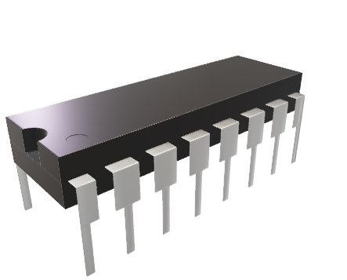
Logic for User Login and Signup_
The program checks the user's choice and proceeds accordingly (login or signup).
If the user chooses signup, the program prompts for a new user ID and password, storing them in IDINPUT and PASSINPUT.
For login, the program checks the entered ID against predefined IDs (IDS1 and IDS2). If a match is found, it prompts for the password. If the password matches, it allows access; otherwise, it gives the user a few attempts to enter the correct password.

Slide 7
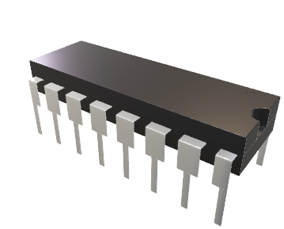
Menu Section_
After successful login or signup, a menu is displayed with various options, such as deposit, withdraw, transfer funds, check balance, etc.
The user's choice is determined using SCAN_NUM.
Depending on the choice, the program executes corresponding logic for transactions like depositing money (ADD_MONEY), withdrawing money (WITHDRAW_MONEY), transferring funds (TRANSFER_MONEY), and checking the balance (CHECK_BALANCE).

Slide 8
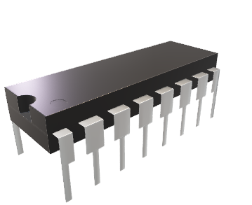
Messages and Error Handling_
The program includes messages for denied access due to wrong passwords, insufficient funds, and other scenarios.
It also includes messages for successful transactions and displays the remaining balance.

Slide 9
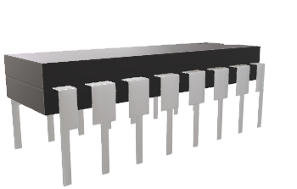
About and References_
The program includes options to display information about the project and references.

Slide 10
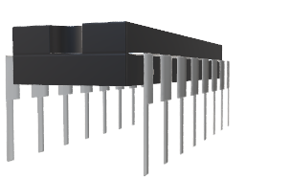
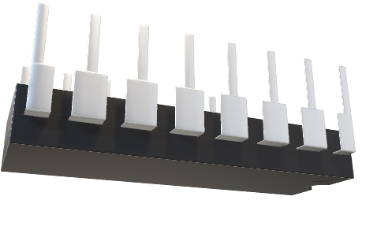
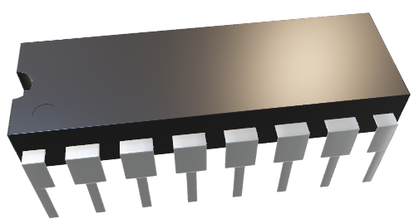
Exiting the Program
The program has options to leave the program, displaying a goodbye message or taking appropriate exit-related actions.

Slide 11
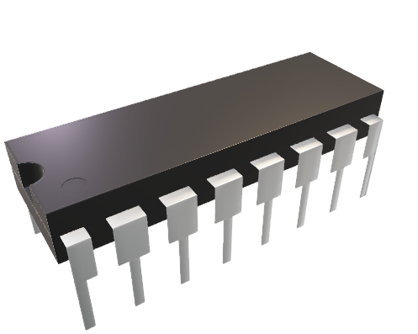
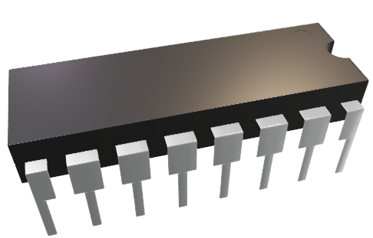
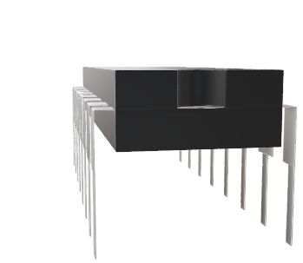
Any Question?

Slide 12
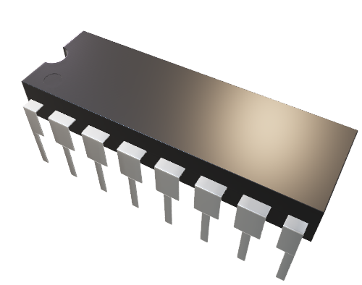
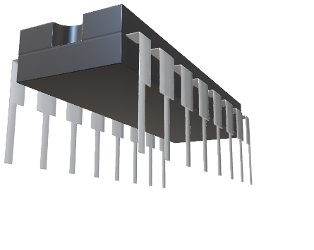
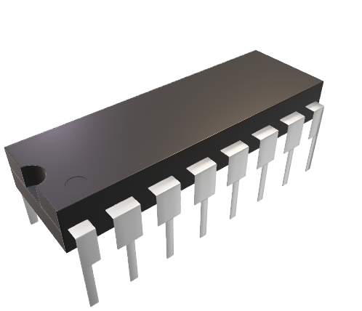
Thanks

